Slide 1

History of the internet
Jarne Everaerts

Slide 2
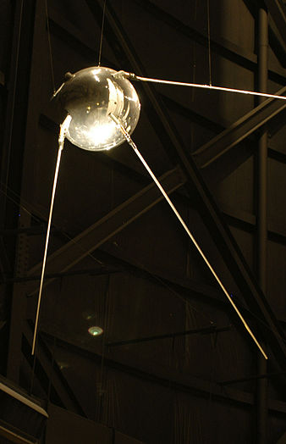
How did it all start
Cold war
Sputnik 1
ARPA
Notes:
4 October 1957 Advanced Research Projects Agency

Slide 3
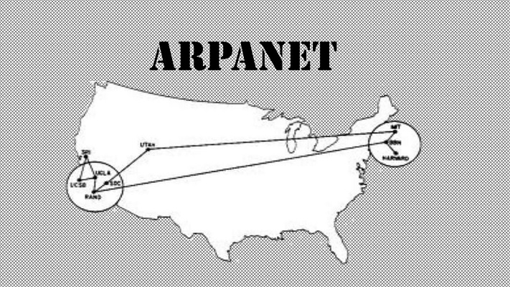
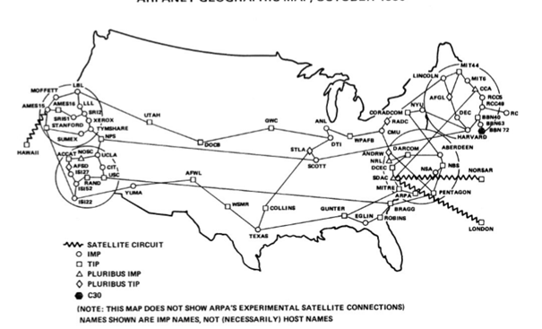
ARPANET
Packet-Switching
Military use
Notes:
Packet-switching: data into packet header = destination payload = data
---\ /--- --- > < --- ---/ \--- interface message processor

Slide 4
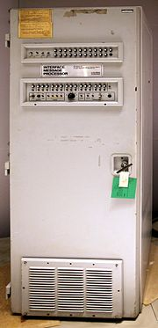
Don’t shoot the IMP
Notes:
Interface Message Processor messenger store forward 1 University of California Los Angeles 2 Stanford Research Institute 3 University of California Santa Barbara
4 University of Utah test login crash on g 1 in 20K tests succeeded

Slide 5
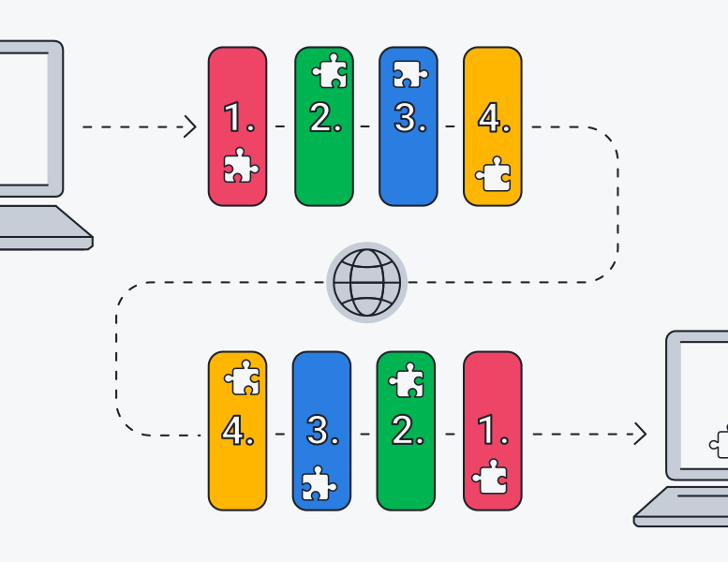
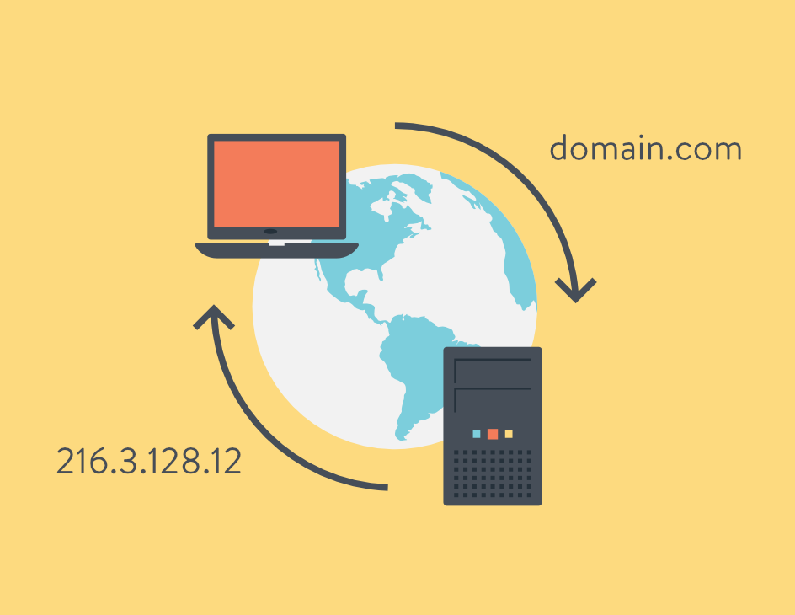
Communication is the Key
Email
TCP/IP
DNS
Notes:
1971 eerste email @ to identify users on arpa 1974 arpa and Stanford Transmission Control Protocol/Internet Protocol 1982 Eunet
1984Domain Name System

Slide 6


Dial up
Notes:
In 1979, Tom Truscott and Jim Ellis
decode audio signals into data
40–50 kbit/s is the norm

Slide 7
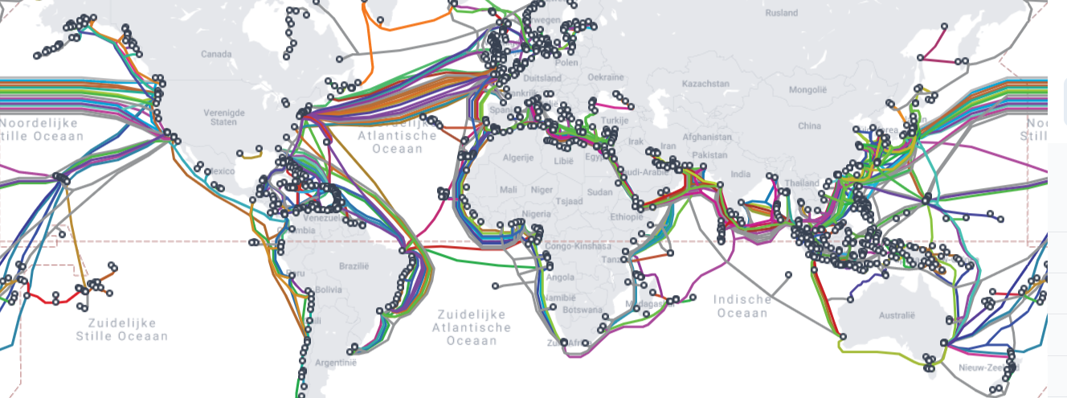
The start of something new

Slide 8
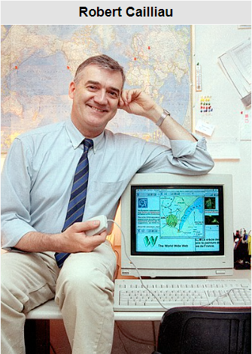
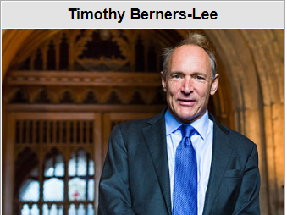
World Wide Web
Notes:
Robert cailliau Tongeren, 26 januari 1947 1974 cern sir timothy berners-lee 8 juni 1955 Londen, Engeland
European Organization for Nuclear Research
HyperText Transfer Protocol http://info.cern.ch/hypertext/WWW/TheProject.html

Slide 9

Mobile Broadband
Notes:
1G analog
1991 finland
2G digital Sms and MMS

Slide 10
Be gentle its my first time
Notes:
1993 Lycos search engine and browser Mosaic
1994: Eerste online-winkel intershop
1995: Eerste online-radio met RealAudio. Eerste toepassingen van Java en JavaScript.
1996: Eerste internettelefonie. Browseroorlog tussen Internet Explorer en Netscape Navigator.
1997: Eerste sociale netwerk. SixDegrees.com.^{[3]}

Slide 11

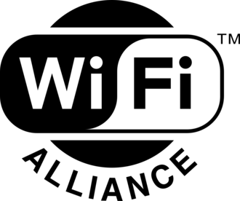
Let's lose these cords
Notes:
21 September 1997
Institute of Electrical and Electronics Engineers
IEEE 802.11 family of standards,
exchange data by radio waves.
2.4 gigahertz (120 mm)
5 gigahertz (60 mm)

Slide 12
Work hard Play harder
Notes:
2007 multimedia instead of work

Slide 13
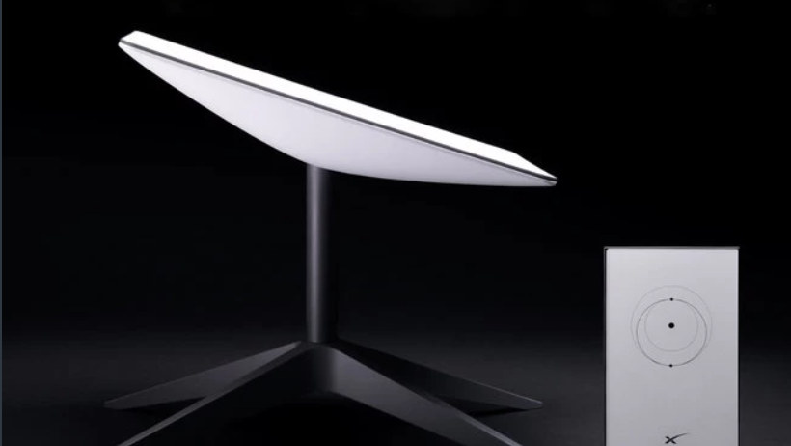
Starlink
Notes:
100 – 500 Mbits
Satellite based internet

Slide 14
